Slide 1

Spark Libraries
Justin Pihony
@JustinPihony | justin-pihony.blogspot.com
Notes:
NEXT: Agenda

Slide 2
Agenda
Basics of Spark
Core API
Cluster Managers
Spark Maintenance
Libraries
SQL
Streaming
MLlib/GraphX
Troubleshooting / Optimization
Future of Spark
Cluster Managers
Spark Maintenance
Notes:
Libraries
SQL
Streaming
MLlib
GraphX
NEXT: SparkSQL

Slide 3
Spark SQL
mystructuredData.registerTempTable(“SparkTable”)
sqlContext.sql(“SELECT * FROM SparkTable
WHERE SomeColumn == ‘SomeData’”)
Notes:
(Named b/c works similar to SQL; wants meet SQL-92 standards)
Allows write declarative code & let engine use data/storage structure to optimize
(Goal is allow user not worry distributed and focus on business)
NEXT: Databricks blog puts it best

Slide 4
As Spark continues to grow, we want to enable wider audiences beyond “Big Data” engineers to leverage the power of distributed processing.
Databricks blog (http://bit.ly/17NM70s)
Notes:
(Read quote)
NEXT: Maintainers just like core

Slide 5


Spark SQL
Maintainers
Michael Armbrust
Reynold Xin
Notes:
(For SQL)
Michael Armbrust, often presenter of subject
Help by core maintainer, Reynold Xin
NEXT: Competitors

Slide 6



Spark SQL
Notes:
Hive; orders magnitude slower; requires oft complex, custom UDF to extend
(Unit testing = nightmare)
(However, more mature and SQL not QUITE full parity..easy extensibility though)
(mechanisms to work w/ existing Hive …even 10-100x faster than pure Hive)
(More on Hive soon)
Apache Drill; fairly new and more than just SQL on Hadoop
For now, let time determine where falls
Impala; C++ tends to beat in direct perf tests
(Built from scratch for specific cases…so especially optimized)
(Combine SQL/ML/Stream/etc…no programming or data flow switch = Spark)
NEXT: AND, another benefit is working w/ multiple data sources

Slide 7




Data Sources
JS
N
CSV
…
Notes:
(Number of which built right in)
Hive; Shark (Hive on Spark); Successful, but coupled;
(Rewritten to decouple, keeping best = SparkSQL)
(If WANT Hive, copy hive-site.xml to SparkHome conf..auto access to Hive metastore)
(Specialized HiveContext for HiveQL; just load Hive data by name)
(Near parity, covering SerDes/UDFs/more)
Other native support = JSON – Parquet
(If not built in, use spark-packages for…)
Avro – Redshift – CSV – More
NEXT: SQL suggested as starting point now, Why?

Slide 8
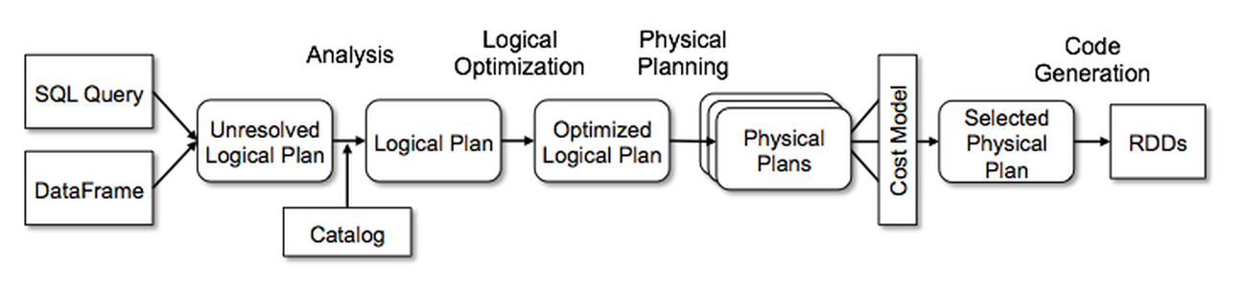
Spark SQL
Optimizations
Predicate push down
Column pruning
Uniform API
Code generation == Performance gains
SQL → RDD → SQL
Notes:
(SQL suggested as starting point now, Why?)
Optimizations – Predicate pushdown – Column Pruning
(Predicate push = filter pushed down, even into datasource)
(Data structure can determine how far…not black box anymore)
(Column prune = rid unnecessary columns…again less data)
(Why keep data around won’t need…save bandwidth)
Uniform interface across languages; DSL for common tasks
Means can compile all down to same JVM bytecode
Complex catalyst engine means even Python boils to the same, Python perf hit gone
Easy SQL->RDD->SQL
(Caveat: SQL loses compile time type safety, stored aptly as Row)
(RDD[Row] via columnar indices back to static; TypedSQL not ready yet)
(Python dynamic allows index by column name)
(So, if RDD is dropped DOWN to…primary abstraction is?)
NEXT: Recall diagram from intro

Slide 9
Spark SQL
DataFrames
Spark
SQL
Spark
Streaming
MLlib
(machine
learning)
GraphX
(graph)
Spark Core
Notes:
Block across all = DataFrame
(Started as SchemaRDD until 1.3 when left Alpha; still aliased for back compat)
(SchemaRDD b/c all it is...data grouped into named cols w/ col metadata as schema)
(Why change name?)
(Underlying is RDD..it isn’t RDD…just glorified table)
(Unification across languages)
(Makes SparkSQL more than SQL)
NEXT: When introduced Databricks stated:

Slide 10
This new API makes Spark programs more concise and easier to understand, and at the same time exposes more application semantics to the engine.
Databricks blog (http://bit.ly/1FBRTBA)
Notes:
(When introduced Databricks stated)
(Read quote)
(As we’ll see in code, use abstraction for SQL OR code (like LINQ))
NEXT: But before, final notes on DataFrames

Slide 11


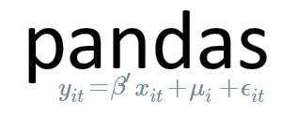
DataFrames
Experimental
SPARK-6116
sqlContext.createDataFrame(pandas)
createDataFrame(sqlContext, RDataFrame)
dataFrame.toPandas()
collect(df)
Notes:
(Mentioned unification across languages)
Influenced by DataFrames in Python – And R
(Name DataFrames unifies beyond Spark)
(Spark oft more performant; Panda and R build for single core and eager execution)
(No predicate pushdown and other lazy wins)
Easily convert from panda/R DataFrame into Spark
Also go other way…although since not dist convert back like collect…must fit driver
Final note: While not Alpha…it’s large and active…
As of 1.5, still Experimental…mostly treated stable even though marked
NEXT: Code it up

Slide 12
Let’s SQL!
Notes:
NEXT: Streaming

Slide 13


Spark Streaming
Maintainers
Tathagata Das
Matei Zaharia
Notes:
Maintained by
Tathagata Das, prefers T D.
NEXT: Is for streaming…as I’m sure you guessed

Slide 14

Spark Streaming
1
Notes:
(Is for streaming…as I’m sure you guessed)
(Very popular)
Takes spark & cranks up speed; fast data; GB/sec
(potential: real time fraud, marketing relevant to NOW search)
Also, backed by core, can boast exactly once transformations w/ failure recover in 1-2 sec
(Only OUTPUT guaranteed, transforms WILL exec mult if fail..side effect code, logging)
(Actions are at LEAST once, so need transactional or idempotent)
NEXT: Competition

Slide 15

Spark Streaming
Notes:
Storm
(Spark tends to win, output 40x)
(Storm at least once, data could duplicate…Trident which slows)
(Again, complete Spark package win; SQL or ML in streaming)
(NOTE: Storm is true stream, Spark micro/minibatch; small deterministic batches)
NEXT: Quick overview of process

Slide 16





Spark Streaming
Streaming
RDD
RDD
RDD
HDFS
…
Notes:
(Number of sources, from…)
Kafka – Flume – Twitter – FS like HDFS – many more
Once hooked up, data flows to Streaming receiver
(1 receiver/stream; increase throughput by multiple source streams and unioning)
Streaming stores incoming data in series of miniRDDs
After each user spec’d time window, tasks sent to core & processed normally
(All simplified behind Dstream)
Note: at least 2 points of processing; receiver & worker
(SO, need 2 CPU’s at minimum; one per input source & at least one for worker)
(Probably want more)
(ALSO, default to using MEM_SER cache…some sources even _2)
(Tends faster throughput)
(_2 speedier failure recovery, _SER reduces GC since one blob = consistent process)
NEXT: Final note before seeing in action!

Slide 17
Spark Streaming
Python API
Notes:
Python API wasn’t til 1.2 and not full parity
Differences noted in docs via a Python API flag
NEXT: See in action!

Slide 18
Let’s Stream!
Notes:
NEXT: MLlib

Slide 19



MLlib
Maintainers
Joseph Bradley
Xiangrui Meng
Shivaram Venkataraman
Matei Zaharia
Notes:
(IMO, most complex topic covered by Spark)
Could be reason behind having most maintainers
Joseph Bradley – Xiangrui(zyangrey) Meng – Shivaram Venkataraman – Matei
(Not MOST used, but VERY active)
(Algorithms exposed constantly growing/getting more performant)
NEXT: Competitors

Slide 20
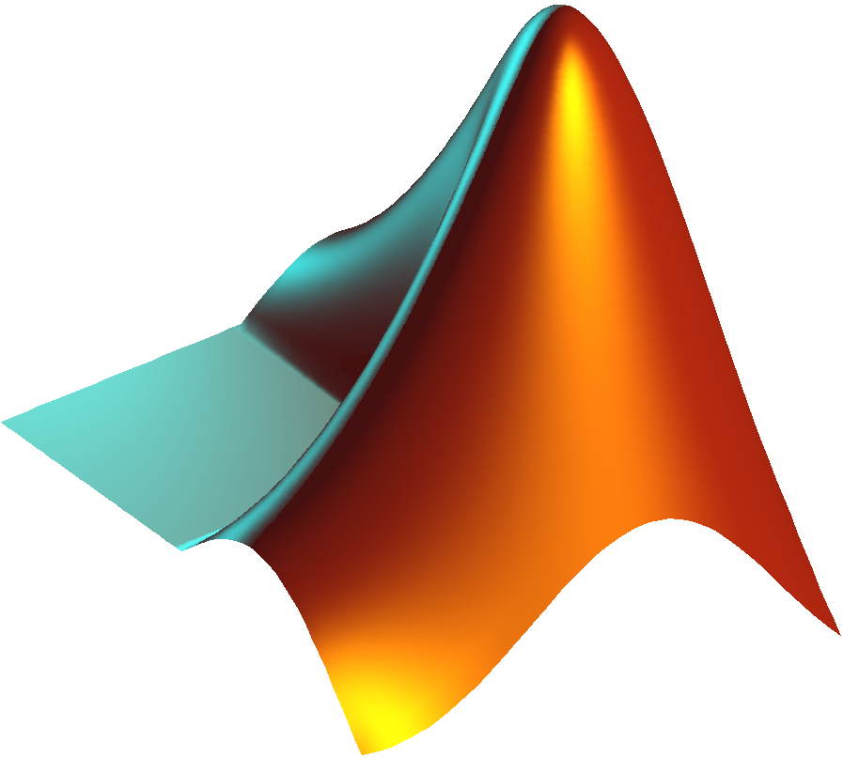


MLlib
ML Optimizer
MATLAB
MLI
MLlib
Notes:
Matlab and R; fairly easy; not scalable
Mahout and GraphLab; more scalable at cost of ease
So MLBase born at Amplab driven by MLStack.
3 pronged approach to make ML easy AND scalable
(MLO and MLI testbeds for pipelines and alg development)
Mllib; productionized impl from testbeds
NEXT: Mllib has subsumed most of stack

Slide 21
MLlib
org.apache.spark.mllib
MLlib
Notes:
(Mllib has subsumed most of stack)
(mllib where orig RDD-based algs reside)
NEXT: AND…(ml namespace)

Slide 22
MLlib
org.apache.spark
.mllib
.ml
Notes:
ML namespace = higher level pipeline API on top dataframes (like MLO)
(pipelines started 1.2 to simplify ML)
(embrace ML flow: load data, extract features, train data, and test)
(Standard interface allows tune, test, & early failure detect)
NEXT: What are some algs

Slide 23
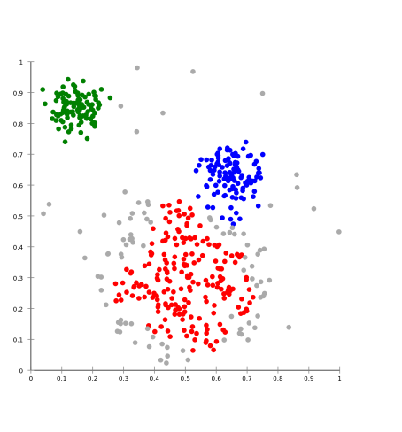




MLlib
Algorithms
Classification
Regression
Collaborative Filtering
Clustering
Dimensional Reduction
Feature Extraction and Transformation
?
Notes:
Classifications: Naïve Bayes
Regressions: Logistic and Linear
Collaborative Filtering: ALS
Clustering: K-Means
Dimensional Reduction: SVD, singular value decomposition
(Just a handful)
(Use caching for iterative approached algs perf gains)
Also helpful feature extract and transformation methods: TFIDF
(Term Freq, Inv Doc Freq)
(How about uses?)
Spam filtering – Fraud detection – recommendation analysis
Determine info clusters – Speech Recog
(MLlib attempting bring complex subject larger audience than previously possible)
NEXT: Code

Slide 24
Let’s Learn!
Notes:
NEXT: GraphX

Slide 25


GraphX
Maintainers
Ankur Dave
Joseph Gonzalez
Reynold Xin
Notes:
Maintained by
Ankur Dave – Joseph Gonzalez – Reynold Xin.
(What is GraphX?)
(Library that brings Spark's table-like structure into a graph structured world)
(like social networking)
(unifying data parallel and graph parallel analytics)
NEXT: In fact, that’s name of original academic paper

Slide 26
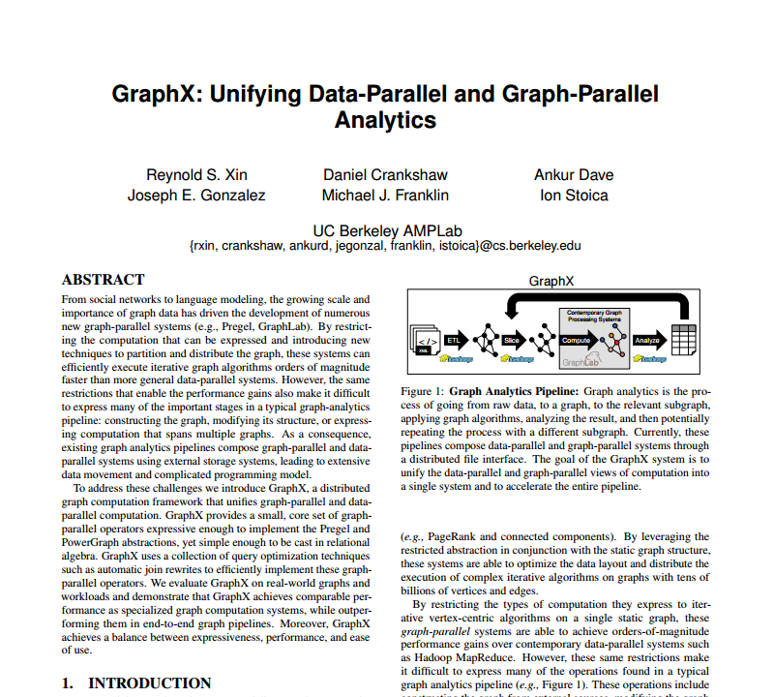
Notes:
(In fact, that’s name of original academic paper)
NEXT: Works by using RDD behind scenes as rest libraries

Slide 27
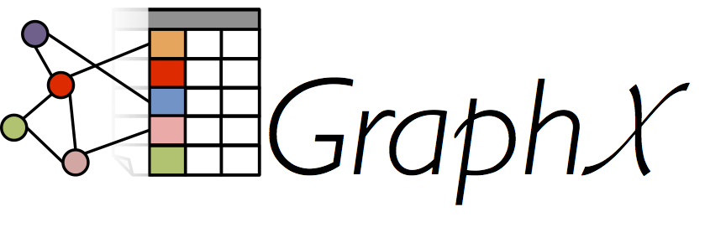
Notes:
(Works by using RDD behind scenes as rest libraries)
(Stores data in graph optimized struct named Graph (ITS higher level abstraction))
(Uses Graph parallel pattern = each node computation depend on neighbor)
(Specializations bring impressive perf gains, but first)
NEXT: Competition

Slide 28

Notes:
Hadoop = mess; not built for it
Giraph is, but GraphX PageRank 2x
GraphLab, only 33% slower
(Seems GraphX, but some cases for other)
(SO, if ONLY graphing, then evaluate…if using other Spark parts, clear choice IMO)
NEXT: What are the usecases

Slide 29



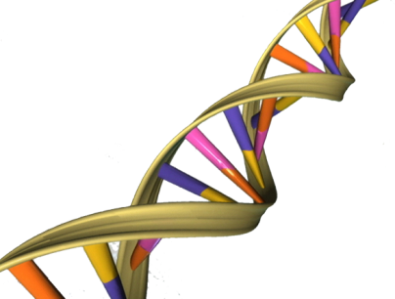


Notes:
Web itself is giant graph; Pagerank for site ranking
Social networks; plenty analysis there
Product evaluation
Genetic analysis!
NEXT: Dig into the mechanics

Slide 30
1
4
6
2
5
3
Notes:
THIS is a graph,
("a directed multigraph with properties attached to each vertex and edge“-Spark doc)
What does that MEAN?
NEXT: Let’s break it down to components

Slide 31
6
1
4
Justin Pihony
6
2
Vertex
5
3
(VertexId, VType)
(Long, VType)
Notes:
(Let’s break it down to components)
1st circular joints; unique id.
Definition “ability to attach properties”, so ID AND metadata
(Example represents person…as social graph maybe)
Known as vertex
Tuple[VertexId, UserDefinedType]
VertexId alias for Long; so simply a number and value
NEXT: That’s joint, what about connecting arrows

Slide 32
1
Friend
4
6
2
Edge
5
Edge(VertexId, VertexId, EType)
3
Edge(Long, Long, EType)
Notes:
Also able to store data; Here store relationship between person vertices
Edge
Own class: Edge(VertexId, VertexId, property 2 verts share)
VertexId still Long, so just 2 numbers and value
NEXT: Add them together

Slide 33
1
4
6
4
Friend
6
Bob Smith
Justin Pihony
2
EdgeTriplet
5
3
Graph[VType,EType]
Graph(RDD[Vertex], RDD[Edge])
Notes:
And you have a graph
Built from 2 RDDs; one of vertices, other edges; That’s IT
Is ONE more component important while working graphs
View of a full connection
EdgeTriplet containing all info for each connection
(Completes the view, graphing easier to reason)
NEXT: Code

Slide 34
Let’s Graph!
Notes:
NEXT: Resources

Slide 35
Resources
SQL
https://ogirardot.wordpress.com/2015/05/29/rdds-are-the-new-bytecode-of-apache-spark/
https://databricks.com/blog/2015/03/24/spark-sql-graduates-from-alpha-in-spark-1-3.html
Michael Armbrust: https://www.youtube.com/watch?v=xWkJCUcD55w
Streaming
http://techblog.netflix.com/2015/03/can-spark-streaming-survive-chaos-monkey.html
https://databricks.com/blog/2015/07/30/diving-into-spark-streamings-execution-model.html
TD: https://www.youtube.com/watch?v=mKdm4NCtYgk
MLlib
Ameet Talwalkar: https://www.youtube.com/watch?v=qSPqh7DiREM
GraphX
https://amplab.cs.berkeley.edu/wp-content/uploads/2014/02/graphx.pdf
Joseph Gonzalez & Reynold Xin: https://www.youtube.com/watch?v=mKEn9C5bRck
https://spark.apache.org/docs/latest/[LIBRARY]-programming-guide.html (mllib-guide)
Notes:
(Barely covered top layer, so resources!)
SQL
Driven by DataFrames; article covers DF make Spark easier/approachable
(RDDs only fallback? Like bytecode)
SQL graduate alpha; covers highlights w/ examples
Michael Armbrust’s SQL presentation Spark Summit digs deeper
Streaming
Netflix chaos monkey results
Databricks post, more streaming details
Older TD talk but relevant (IMO older talks dove into nitty gritty, newer are high level)
Mllib – Ameet Talwalkar talk
(best on subject IMO not TOO high or low level..good for non ML experts like me)
GraphX – Original academic paper (dense)
Joseph Gonzalez & Reynold Xin talk 2013…syntactically wrong? But mechanics sound
Always official docs
(Standard URL different for mllib for some reason, missing word programming)
NEXT: Summary/Questions

Slide 36
Summary
SQL
DataFrames
Streaming
MLlib
GraphX
Notes:
Questions?

